Slide 1
wELCOME TO THE BISHOPS’
The Reception Year

Slide 2
The Early Years Foundation Stage (EYFS) curriculum is used by professionals working with children from birth to 5 years old. This means that your child will continue to work in a similar way to that of their previous setting (nursery/ preschool) during their first year at The Bishops’.

Slide 3
The Characteristics of Effective Learning

Slide 4
Areas of learning

Slide 5
Learning Journeys
All Foundation Stage staff will document your child’s learning as they play, taking photos and writing notes.
The document where these observations are kept is called a ‘Learning Journey’.
You will have opportunities throughout the year to come and look through the Learning Journeys.
You are encouraged to record your child’s achievements out of school on a ‘Wow Voucher’ which can then be stuck into the Learning Journeys.

Slide 6
What your child will need at school…
Water bottle (with name label)
Bishops’ school bag (with name label)
Reading record (this will be provided when your child starts)
PE kit (all items of clothing with name labels)
A change of clothes for accidents (all items of clothing with name labels)
School Uniform (all items of clothing with name labels)

Slide 7
What a day at school will look like to begin with…
8.45 – Arrive at school
9.00 – Register
9.05 – Carpet time
9.20 – Choosing time
10.15 – Snack time – Healthy snacks are provided by the school
10.30 – Choosing time
11.30 – Story/ Singing time
12.00 – End of day prayer then home time/ Lunch time prayer
then lunch time

Slide 8
What a day at school will look like to begin with…
1.00 – Carpet time
1.20 – Choosing
2.25 – Tidy
2.30 – Song/ Story/ Reflect on the day’s learning
2.45 – Prepare for home time
3.00 – End of day prayer and home time

Slide 9
Things your child should not have in school…
Toys (not including items related to class topics)
Sweets
Fizzy drinks/ Squash (only water should be provided in your child’s drink bottle)
Nutella/ Peanut butter or any food items containing nuts
Jewellery – your child will not be able to participate in PE lessons if they are wearing earrings (your child’s PE day will be announced in September)

Slide 10
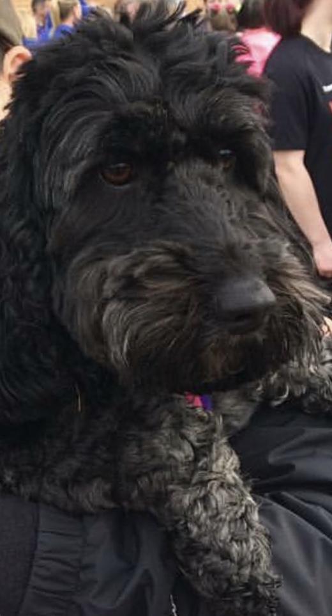
Introducing…
Luna our school dog

Slide 11
These are our hopefully, up-and-coming events…
Welcome talk in October (date to be confirmed)
Parent/teacher meetings Via phone calls (Monday 13th July)
There will be various learning talks throughout the year where teachers will discuss areas of learning in more depth (reading, writing, mathematics etc.).
There will also be coffee mornings where parents and teachers can meet informally to ask questions.
Teachers will be sending video presentation and a ‘tour guide’ of the school ☺

Slide 12
Some things to do over the Summer holiday…
Relax
Talk positively about the next step…BIG SCHOOL!
Visit the TLC website
Watch some Jolly Phonics videos (phase 2 only)
Lots of careful counting of natural objects
Number blocks on Cbeebies – great for developing understanding of
number
Encourage initial name writing

