Slide 1
The Bishops’
Welcome

Slide 2
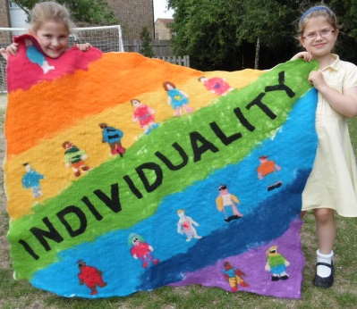
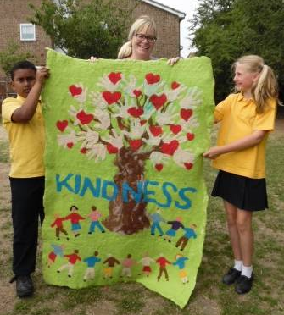
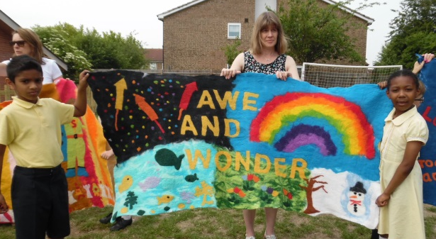
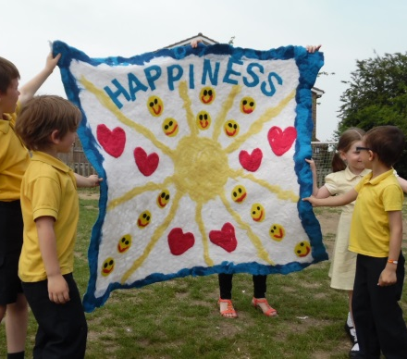
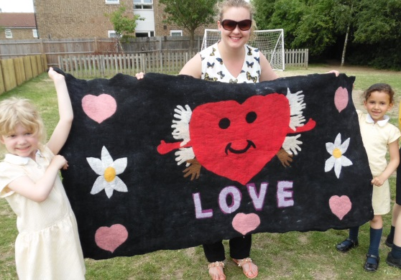
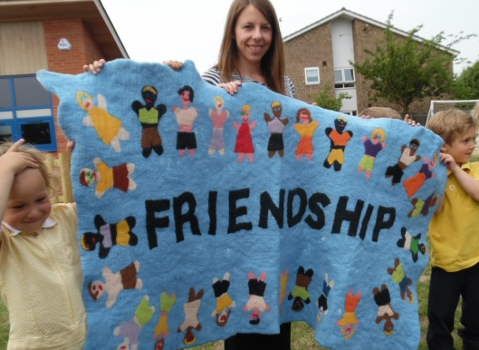
The Bishops’ Motto
Live fully, Laugh often, Learn deeply, Love as God loves you…… ….and let your Light shine!

Slide 3
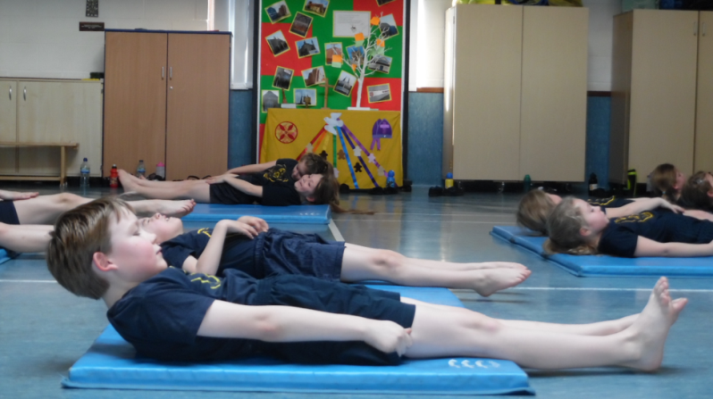
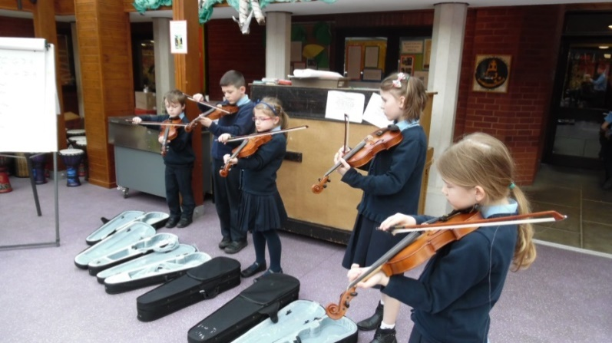
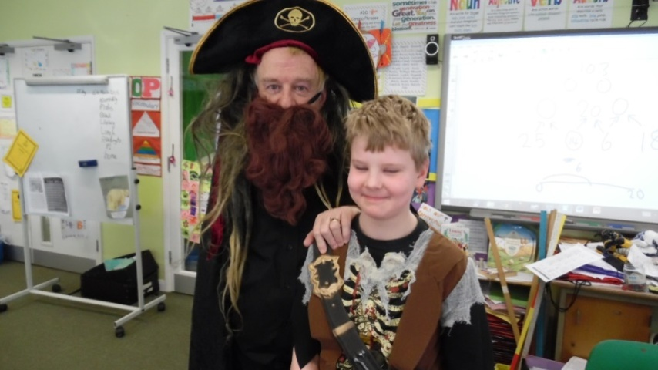
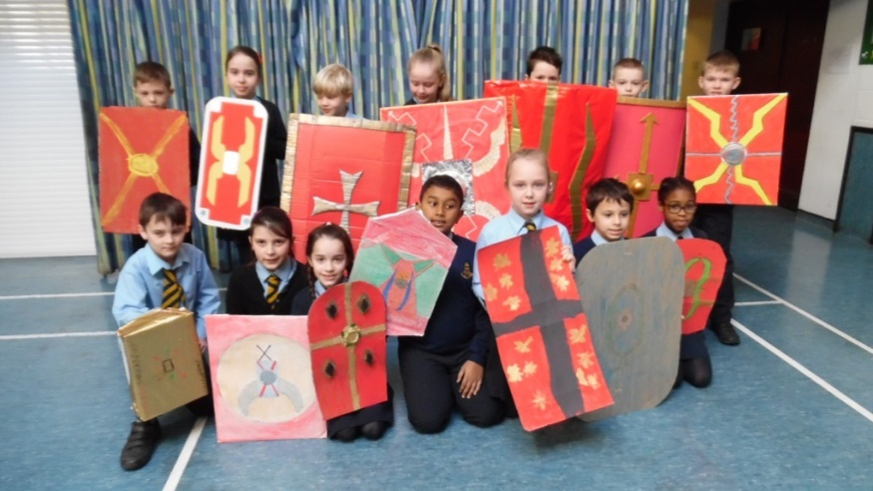
What we are about Academic, Social, Emotional and Spiritual learning

Slide 4
So you want your children to do well?
…….and be happy…….and emotionally stable…….
So do we.
Some researchers did a review of lots of evidence around how well children did in school….
The Impact of Parental
Involvement, Parental Support
and Family Education on Pupil
Achievements and Adjustment:
A Literature Review
Professor Charles Desforges
with
Alberto Abouchaa And this is what they found…….

Slide 5
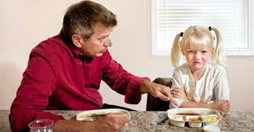
They found that…… children’s achievement and adjustment were effected much more positively by ‘good parenting’ than by ‘good schooling’. You are more important than us…. What you value is more important than what we value.
The most important finding from the point of view of this review is
that parental involvement in the form of ‘at-home good parenting’ has
a significant positive effect on children’s achievement and adjustment
even after all other factors shaping attainment have been taken out of
the equation. In the primary age range the impact caused by different
levels of parental involvement is much bigger than differences
associated with variations in the quality of schools. The scale of the
impact is evident across all social classes and all ethnic groups.

Slide 6
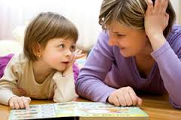
Parents with their children
‘The more parents and children talked and discussed in the home, the more the pupils achieved in school…..’
Achievement in both maths and reading was also significantly related to
family social class. The researchers used statistical techniques to factor
out this effect and then examined the residual impact of parental
involvement factors. They concluded that, ‘parental involvement made a
significant unique contribution to explaining the variation in children’s
academic achievement over and above the effects associated with family
background’ (p.138). To be precise, the most significant factor was ‘home
discussion’. Regardless of social class, the more parents and children
conversed with each other in the home, the more the pupils achieved in
school.

Slide 7
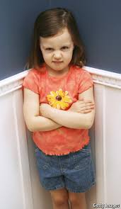
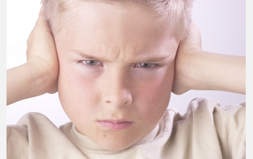
Mums are better at this than dads. Naughty children get less attention – at least at home.
Since this study reveals home discussion to be a significant force on student
achievement it is worth noting some of the factors associated with this form of
parental involvement. First there is a strong gender effect. Females report
considerably more home discussion than males. Second, children with
behavioural problems get less home discussion but significantly more school
communication.

Slide 8
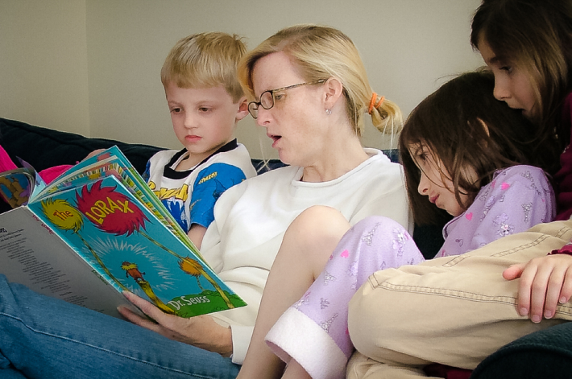
The Home Learning Environment is incredibly important
The idea of a ‘home learning environment’ (HLE) was devised to describe a range of learning related provision in the home as reported by parents. HLE
included reading, library visits, playing with letters and numbers, painting
and drawing, teaching (through play) the letters of the alphabet, playing
with numbers and shapes, teaching nursery rhymes and singing. Melhuish
et al (2001) concluded that, ‘higher home learning environment was
associated with increased levels of cooperation and conformity, peer
sociability and confidence, … lower anti-social and worried or upset
behaviour and higher cognitive development scores … after age it was the
variable with the strongest effect on cognitive development’
It includes reading, library visits, playing with letters and numbers, painting
and drawing, teaching (through play) the letters of the alphabet, playing
with numbers and shapes, teaching nursery rhymes and singing.

Slide 9
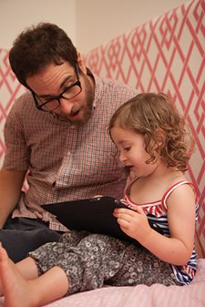
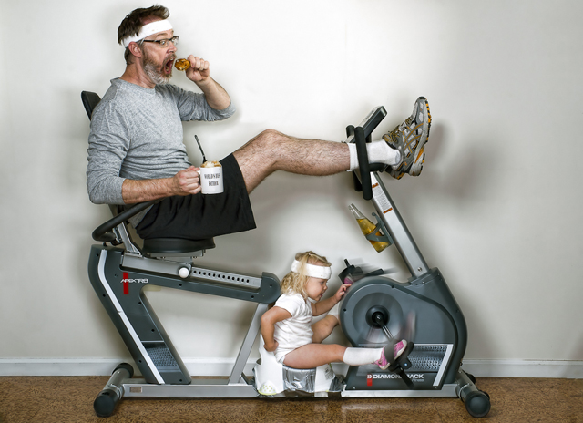
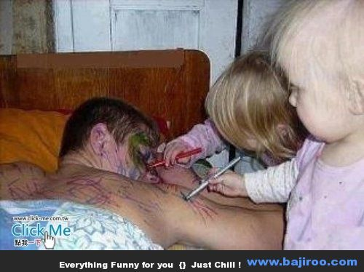
Dads are important, too.
‘More recently, a father’s interest in his child’s education, particularly at age 11, has been found to have more influence than family background, the child’s personality or poverty on education success ‘
Children of involved fathers are more likely to live in cognitively stimulating homes (Williams & Sternberg, 2002) and fathers’ commitment to the education process also matters. In 1992, British sociologists Dennis & Erdos found unemployed fathers’ support for their children’s education strongly connected with those children’s escape from disadvantage. More recently, a father’s interest in his child’s education, particularly at age 11, has been found to have more influence than family background, the child’s personality or poverty on education success (Hango, 2007). Blanden (2006) found low fatherly interest similarly predictive – in the other direction: a father’s low interest in his son’s education, for instance, reduces his boy’s chances of escaping poverty by 25%.

Slide 10
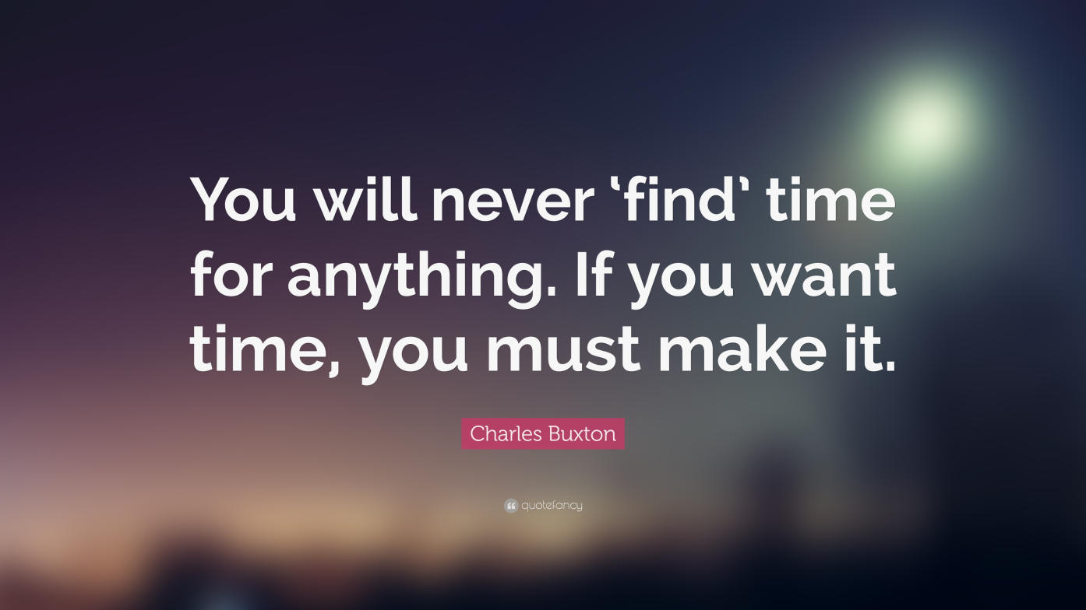
The most important thing

Slide 11
Dos and Don’ts
Teach your child to dress and undress
Play board games, I-Spy…
Share and talk through chores
Junk model
Encourage making marks – it’s pre-writing
Read
Sing
Play with your child
Encourage independence
Go on holiday during the school holiday times
Park well!
Send your child to school with impossible fastenings
Worry about their progress/ compare with others – they are all different
Be too academic at home – play!
Be too busy with clubs etc
Be controlled by computer games/ TV
Forget the value of your extended family if available
Wait until tomorrow to resolve a conflict

Slide 12
If there’s a problem…. (which there will be)
Let your children develop their own relationships and work out their own problems – don’t get too involved except as providing the strongest possible environment at home of love and security.
Talk to us early on. Work with
us. Trust us.
Your children have to know we are a team.
Support the school in the presence of your children.
Normalise anxiety and provide confident hope.

Slide 13
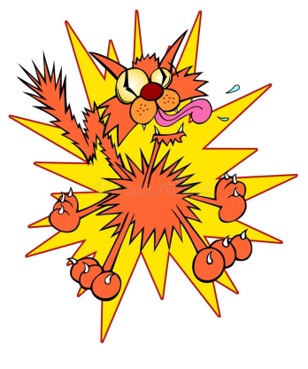
In the pack, and some other bits….
Permissions…….trips/ visits and photos
Home-school Agreement
Your contact details
Dinner and other payments
Little Fingers
Donations

Slide 15
Love life – and teach your children to.
Thank you for listening – we are looking forward to working
with you and your children

